Slide 1
ARTIFICIAL INTELLIGENCE & MACHINE LEARNING
UNIT II

Slide 2
Learning Objectives
Knowledge Representation and Reasoning:
Approaches to knowledge representation
Propositional Logic
First Order Predicate Logic
Inference Rules
(Modus Ponen, Modus Tollen, Resolution, And elimination, Syllogism
Production Rules
Types of knowledge
Reasoning: Forward and backward reasoning
Non-monotonic Reasoning
Reasoning with uncertainties

Slide 3
Approaches to knowledge representation
A variety of ways representing knowledge have been used in AI programs.
  A knowledge level: where facts has been described.
  The symbol level: Where representation of the objects at knowledge level are defined in terms of symbols that can be manipulated by the program to achieve the goal.
The Knowledge representation models/mechanisms are often based on:
  Logic
  Rules
  Frames
  Semantic Network
Facts
Representation

Slide 4
Approaches to knowledge representation (contd.)
  The base for Knowledge based agent is termed as Knowledge Base (KB)
  This KB consists of set of sentences that represents as knowledge representation language.
  When the sentence is taken without being derived from other sentences, we call it as AXIOMS.
  There must be a way to add more sentences to knowledge base, and to query what is already known.
    TELL and ASK

Slide 5
Approaches to knowledge representation (contd.)
  Inference: Deriving new sentences from old one.
  Inference must obey the requirements that when one ASK a question of the knowledge base, the answer should follow from what has been TOLD to the KB.
  A knowledge based agent can be built by TELLING ut what it needs to know.
  Starting with empty KB, the agent can tell sentence one by one until the agent know how to operate its environment. → Declarative approach.
  When encoding is done for desired behavior properly and directly→ Procedural approach.

Slide 6
Logic
  Syntax: The structure of sentence
  Semantics: the way in which truth of sentence is determined.
  X+Y=4
The atomic sentences consist of a single proposition symbol. P,Q,W_{1,3} and FacingEast.
Complex sentence are constructed from simpler sentences, using parentheses and operators → Logical connectives.

Slide 7
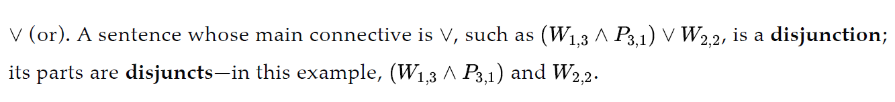
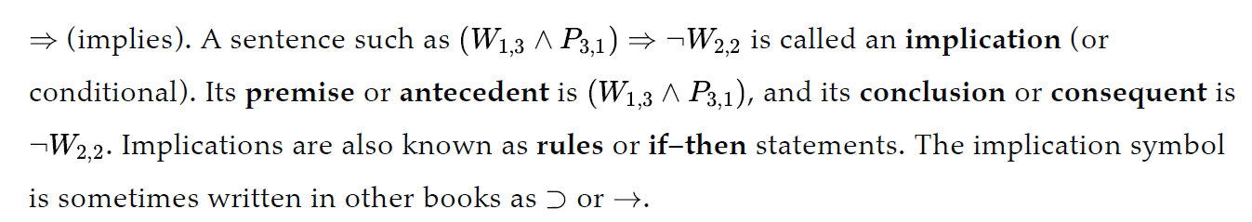
Logic (contd.)
  There are 5 common connectives:

Slide 8
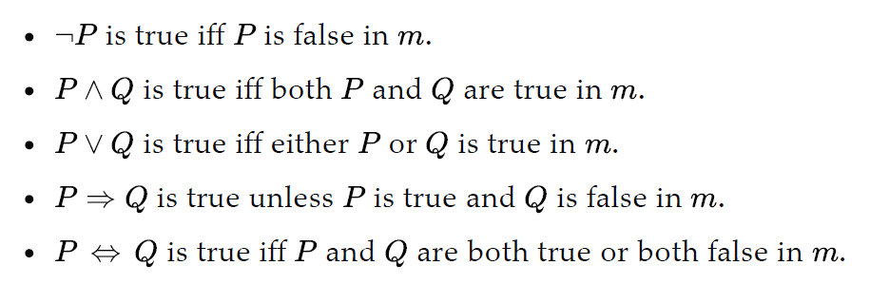
Logic (contd.)
    For atomic sentences:
      True is true in every model and false is false in every model.
    For complex sentences:

Slide 9
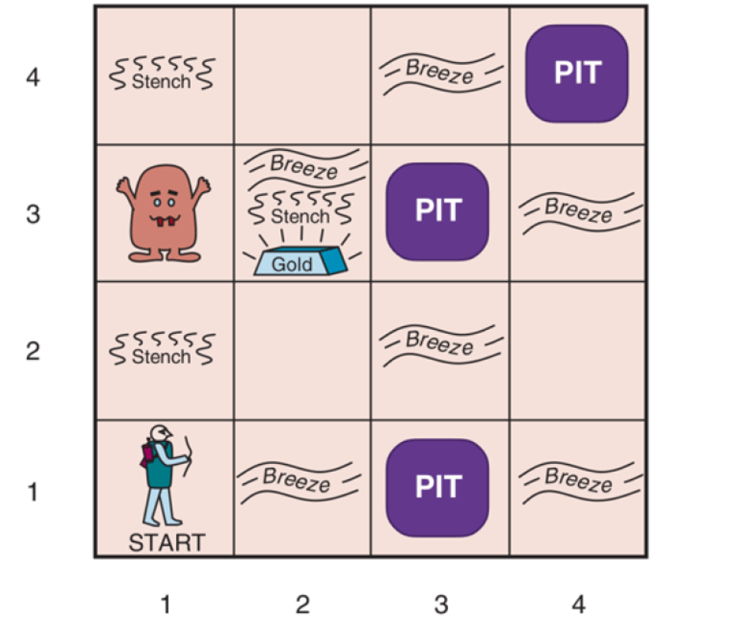
A Typical Wumpus World!!!

Slide 10
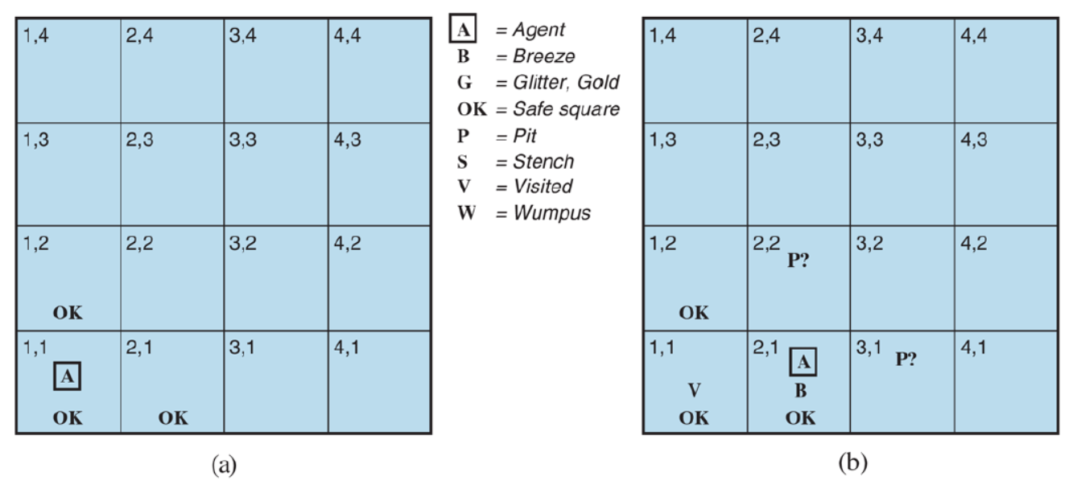
Learning Objectives

Slide 11
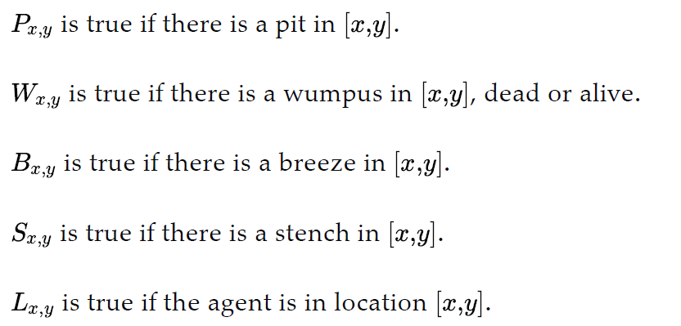
A simple Knowledge Base

Slide 12

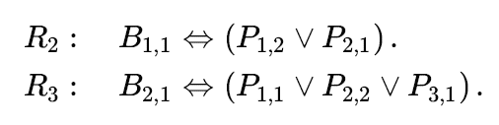
A simple Knowledge Base (contd.)
There is no pit in [1,1]
A square is breezy if and only if there is a pit in a neighboring square. Now this has to be stated for every square.
Write a relation if square B_{2,1} is breezy

Slide 13
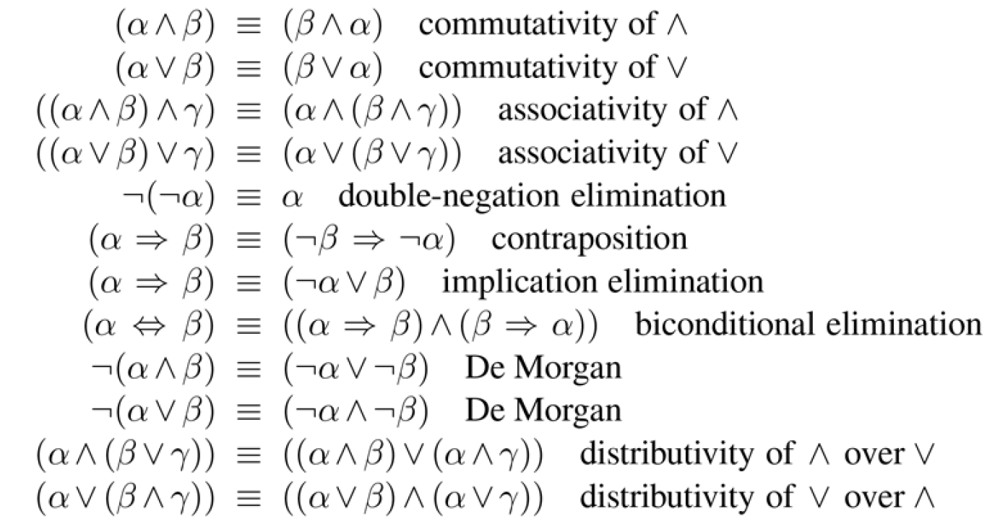
Standard Logical Equivalences

Slide 14
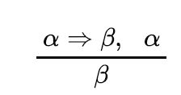


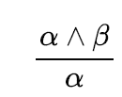
Inference and proofs
The rules can be applied to derive a proof→ a chain of conclusion that leads to the desired goal.
The best known rule is MODUS PONENS.
Whenever any sentence of the form are given, then the sentence can be inferred.
And-Elimination

Slide 15
First Order Predicate Logic
In propositional logic, we can only represent the facts, which are either true or false.
The propositional logic has very limited expressive power.
First-order logic is another way of knowledge representation in artificial intelligence. It is an extension to propositional logic.
First-order logic is also known as Predicate logic or First-order predicate logic. First-order logic is a powerful language that develops information about the objects in a more easy way and can also express the relationship between those objects.

Slide 16
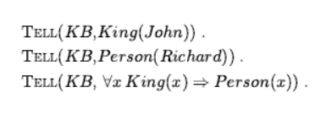
Using First Order Predicate Logic
In knowledge representation, a domain is just some part of the world about which we wish to express some knowledge.
Sentences are added to KB using TELL, just like we did in propositional logic. These are termed as assertions.
Ask question of the KB using ASK. These are termed as queries or goals.
ASK(KB,King(John))

Slide 17

Quantifier
Universal Quantifier
  The sentence says, “For all x, if x is a king, then x is a person.” The symbol x is called a variable.
Existential quantification (∃)
  we can make a statement about some object without naming it, by using an existential quantifier

Slide 18
Statements
All boys like football
Some girls like basketball
Some girls hate pumpkin
All boys hate potato
Every person who buys a PlayStation is smart
No person buys expensive gifts
Not all students like both mathematics and Science

Slide 19
Questions
Not all students like both Mathematics and Science.
Only one student failed in Mathematics.
None of my friends are perfect.
John does not love anyone
Everyone loves someone.

Slide 20
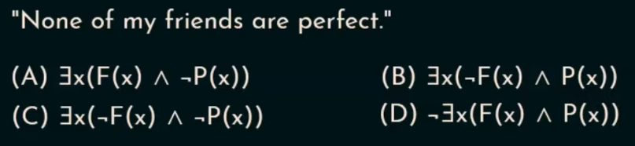
Questions

Slide 21
Clause
Definite Clause: A clause which is a disjunction of literals with exactly one positive literal is known as a definite clause or strict horn clause.
Horn Clause: A clause which is a disjunction of literals with at most one positive literal is known as horn clause.
Hence all the definite clauses are horn clauses

Slide 22
Forward Reasoning
Forward reasoning is a process in artificial intelligence that finds all the possible solutions of a problem based on the initial data and facts.
The forward reasoning is a data-driven task as it begins with new data.
In forward reasoning, the first step is that the system is given one or more constraints.
Forward reasoning follows the Bottom-up approach.

Slide 23
Forward Reasoning (Contd.)
Rules
A & C →E
A & E →G
B →E
G →D
Prove A & B →D
DB== AB present

Slide 24
Backward Reasoning
It is a goal- driven task.
Backward reasoning begins with some goal
Backward reasoning is a top-down approach.
Rules:
F & B→Z
C & D →F
A →D
In facts : A E B C

Slide 25
Reasoning under Uncertainties
Till now, we have learned knowledge representation using first-order logic and propositional logic with certainty, which means we were sure about the predicates.
With this knowledge representation, we might write A→B, which means if A is true then B is true, but consider a situation where we are not sure about whether A is true or not then we cannot express this statement, this situation is called uncertainty.
So to represent uncertain knowledge, where we are not sure about the predicates, we need uncertain reasoning or probabilistic reasoning.

Slide 26
Probabilistic Reasoning
A knowledge representation where the concept of probability is applied to indicate uncertainty.
Need of probabilistic reasoning in AI:
  When there are unpredictable outcomes.
  When specifications or possibilities of predicates becomes too large to handle.
  When an unknown error occurs during an experiment.
  Probability: Probability can be defined as a chance that an uncertain event will occur. It is the numerical measure of the likelihood that an event will occur. The value of probability always remains between 0 and 1 that represent ideal uncertainties.
  Conditional Probability

Slide 27
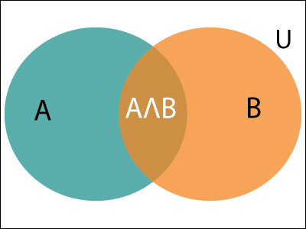
Probabilistic Reasoning

Slide 28
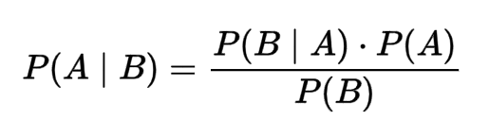
Bayes’ theorem in Artificial Intelligence
Bayes' theorem is also known as Bayes' rule, Bayes' law, or Bayesian reasoning, which determines the probability of an event with uncertain knowledge.
It is a way to calculate the value of P(B|A) with the knowledge of P(A|B).

Slide 29
Bayes’ theorem in Artificial Intelligence
P(A|B) is known as posterior, which we need to calculate, and it will be read as Probability of hypothesis A when we have occurred an evidence B.
P(B|A) is called the likelihood, in which we consider that hypothesis is true, then we calculate the probability of evidence.
P(A) is called the prior probability, probability of hypothesis before considering the evidence
P(B) is called marginal probability, pure probability of an evidence.

Slide 30
Bayes’ theorem in Artificial Intelligence
Question: From a standard deck of playing cards, a single card is drawn. The probability that the card is king is 4/52, then calculate posterior probability P(King|Face), which means the drawn face card is a king card.

Slide 31
Reasoning
Differentiate between Monotonic and Non-Monotonic Reasoning

Slide 32
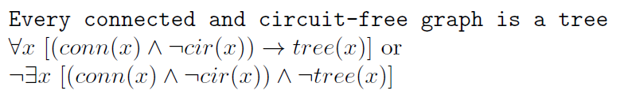
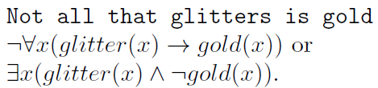
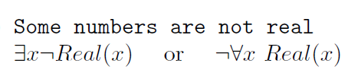
Questions

Slide 33
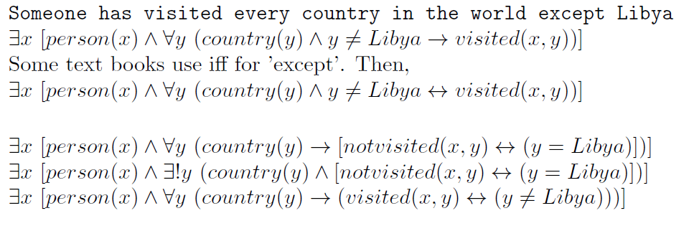
Questions

